Slide 1
Memory Management in Android Apps

Slide 2


Hello!
I’m Lee McCauley
I am a software developer and agile practitioner at
You can find me at @agileatheist

Slide 3


Place your screenshot here
I was part of the team that built the first Android app for Panera Bread and have recently been helping
Enterprise Rent-a-Car create a tablet app to make renting a car that much easier.

Slide 4
Android is Java
(and not Java)

Slide 5
Android is Linux
(kinda)

Slide 6
How much memory a process uses is really not clear. Add on top of that paging out to disk (let alone swap which we don't use on Android) and it is even less clear. Thus if you were to take all of the physical RAM actually mapped into each process, and add up all of the processes, you would probably end up with a number much greater than the actual total RAM.
-Kyle, Stack Overflow

Slide 7
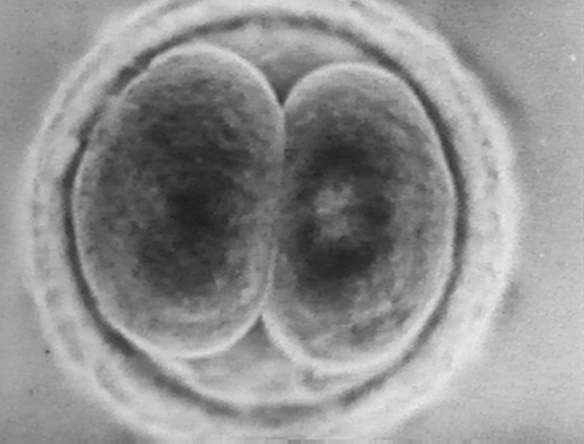

Slide 8
adb (Android Debug Bridge)
Android’s command line interface to your device from another computer

Slide 9
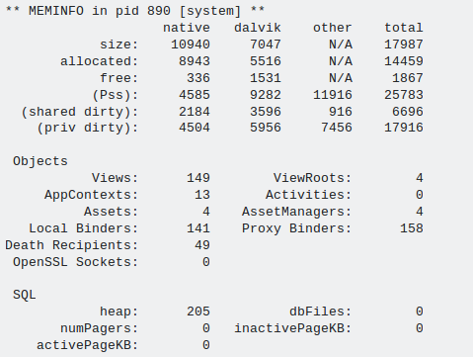
adb shell dumpsys meminfo

Slide 10
adb shell dumpsys meminfo

Slide 11
adb shell dumpsys meminfo

Slide 12
But it’s Java! Doesn’t the garbage collector handle this?

Slide 13
Yes! But...

Slide 14
Biggest memory issues
Anonymous Inner classes (leak)
Hard references to Activities (leak)
Bitmaps scaled UP
Services running in the background

Slide 16
Thanks!

